Slide 1
Welcome and Overview

Slide 2
LOCAL SUB INTRO (Optional)

Slide 3
Quick Introduction
Who am I?
Who are you?
Company and role
Experience with cloud
What is your platform of choice?
What are you looking to learn?
What is Azure?

Slide 4
Course Goals
Provide a jumpstart on development for Azure and Office 365
Understand the options for your platform of choice
Windows, Linux, OSX
What is Azure? What is the Microsoft Cloud?
CODE, CODE, CODE

Slide 5
Microsoft Cloud
Secure Productive Enterprise &
Operations Management + Security
Microsoft AI
Cortana Intelligence Suite
Office 365
Dynamics
Azure
PRODUCTIVITY
BUSINESS APPS
SECURITY & MANAGEMENT
DATA & INTELLIGENCE
APPLICATION INNOVATION

Slide 6
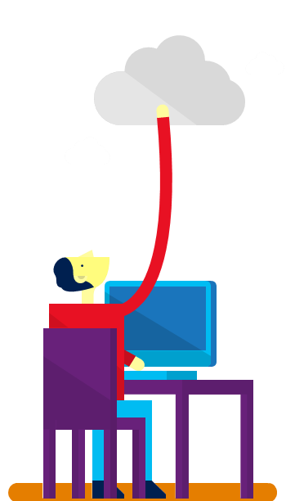











7+ billion
worldwide queries each month
50+ billion
minutes of connections handled each month
250+ million
active users
85%
Fortune 500 users
2.4+ million
emails per day
30+ trillion
objects stored
3.5+ million
subscribers
48+ million
users in 41 markets
50+ million
active users
400+ million
active users
18+ billion
Active Directory authentications per week
200+ Cloud Services
1+ billion customers · 20+ million businesses · 90+ markets worldwide

Slide 7


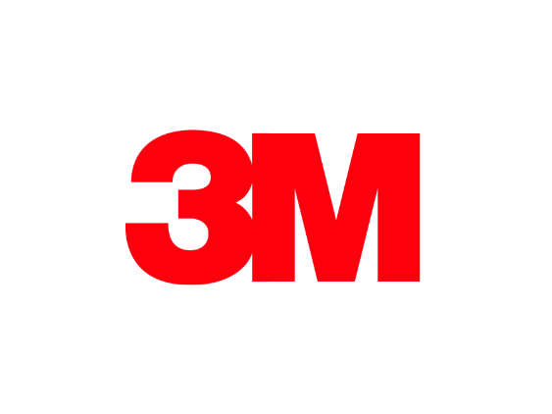



























>90% of Fortune 500 use Microsoft Cloud

Slide 8

42
Azure regions
More than any other cloud provider
RECENTLY LAUNCHED:
US Gov: US Gov Texas and US Gov Arizona
NEWLY ANNOUNCED:
France: France Central and France South
Africa: South Africa North and South Africa West
Notes:
At the core of Azure is its global infrastructure that spans 40 regions worldwide. We have the largest footprint of any cloud provider – 2X that of AWS.
https://azure.microsoft.com/en-us/regions/

Slide 9












































Comply with industry and regional requirements
GLOBAL
ISO 27001
ISO 27018
ISO 27017
ISO 22301
SOC 1 Type 2
SOC 2 Type 2
SOC 3
CSA STAR
Self-Assessment
CSA STAR
Certification
CSA STAR
Attestation
US GOV
Moderate
JAB P-ATO
High
JAB P-ATO
DoD DISA
SRG Level 2
DoD DISA
SRG Level 4
DoD DISA
SRG Level 5
SP 800-171
FIPS 140-2
Section 508 VPAT
ITAR
CJIS
IRS 1075
INDUSTRY
PCI DSS
Level 1
CDSA
MPAA
FACT UK
Shared
Assessments
FISC Japan
HIPAA / HITECH Act
HITRUST
GxP
21 CFR Part 11
MARS-E
IG Toolkit UK
FERPA
GLBA
FFIEC
REGIONAL
Argentina PDPA
EU
Model Clauses
UK
G-Cloud
China
DJCP
China
GB 18030
China
TRUCS
Singapore
MTCS
Australia
IRAP/CCSL
New Zealand
GCIO
Japan My
Number Act
ENISA
IAF
Japan CS Mark Gold
Spain
ENS
Spain
DPA
India
MeitY
Canada
Privacy Laws
Privacy
Shield
Germany IT
Grundschutz
workbook
Notes:
Jan-2017: Azure compliance coverage includes 53 offerings

Slide 10



Build apps faster and easier - IAAS
VM
Containers
Service Fabric
Other
Legacy applications, no change
Efficiency and speed
Always-on, scalable, distributed applications
Cloud Foundry, OpenShift, Apprenda, Jelastic, etc.
Lift and shift
Improved DevOps
Hyperscale
(e.g. IOT)
Third-party frameworks
Notes:
[The 1,000ft View - PaaS services drill down]
Objective:
Define what constitutes the Azure application platform. What are the main services developers need to think about.
Key talking points:
Build on the OS: Virtual Machines are the “base unit” for moving workloads to the cloud. The Azure Container Service provides a really fast way to get containers into production with a choice of popular open source container orchestration solutions: DC/OS or Docker Swarm
Service Fabric: is a platform that developers and ISVs can use to build and manage custom microservice-based applications at cloud scale and with 24x7 availability. Microservices are an architectural approach based on fine-grained, loosely coupled services that can enable advanced developer agility
Other PaaS: all PaaS runs great on Azure! Azure supports the leading third-party PaaS framework providers like Cloud Foundry and OpenShift.

Slide 11

Build apps faster and easier - PAAS
< DEVELOPERS
NON-DEVELOPERS >
App service
Functions
Logic apps
Power apps
Web, mobile, and API apps
Serverless compute
Workflow & Integration
Self-service
Web and mobile
Event-driven microservices
LOB integration and hybrid apps
No-code apps
Notes:
[The 1,000ft View - PaaS services drill down]
Objective:
Define what constitutes the Azure application platform. What are the main services developers need to think about.
Key talking points:
App Service: is a set of services that has everything you need to build apps that target both web and mobile clients from a single app back end. Supporting a range of language options—.NET, Node.js, Java, PHP, and Python—it consists of Web Apps, Mobile Apps, Logic Apps, and API Apps.
Functions: provides serverless, compute for event-driven solutions that extends the existing Azure application platform with capabilities to implement code triggered by events occurring in other Azure services, SaaS products (like Office365 and Salesforce.com), and on-premises systems.
Cloud Services: was the original Microsoft platform as a service (PaaS) service launched in 2010. Inspired by the needs of developers, Cloud Services enabled them to easily deploy .NET applications, taking advantage of cloud infrastructure like Virtual Machines and Virtual Networks without having to manage the low-level details and configuration of Windows Server and the underlying infrastructure.
Other PaaS: all PaaS runs great on Azure! Azure supports the leading third-party PaaS framework providers like Cloud Foundry and OpenShift.

Slide 12







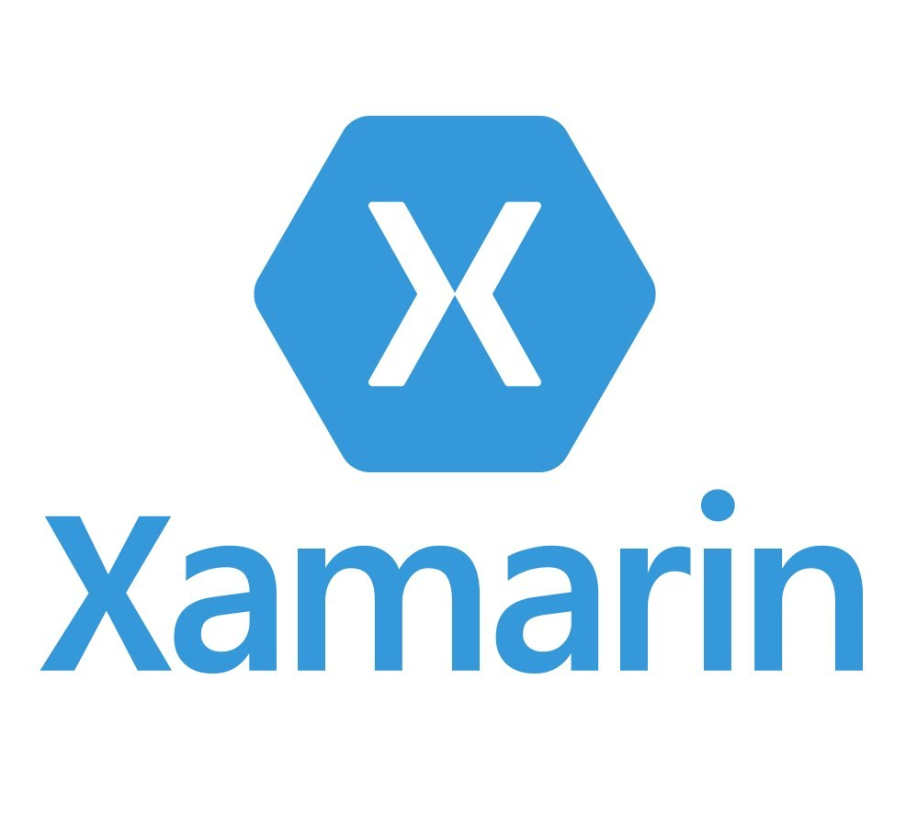
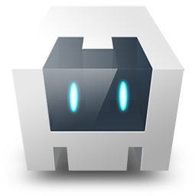

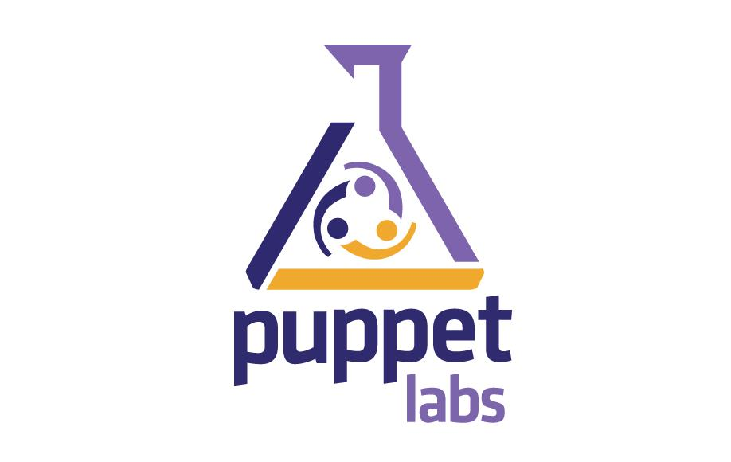

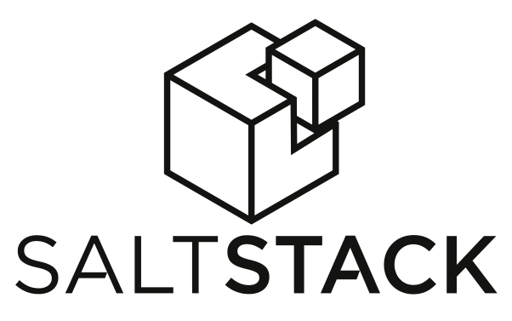



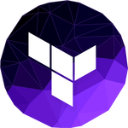

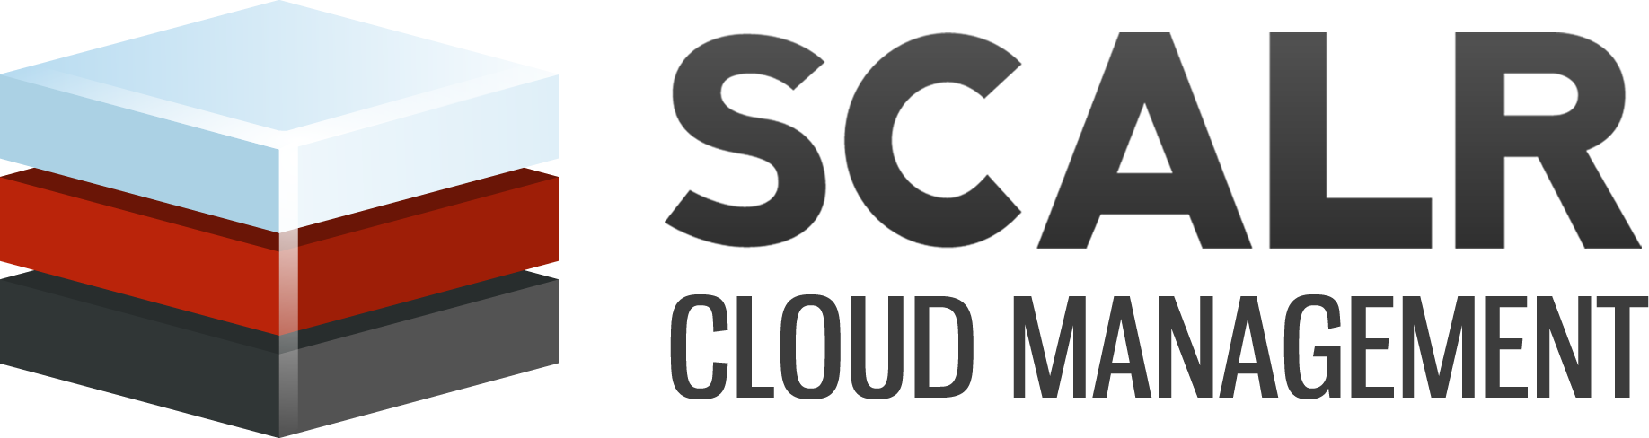
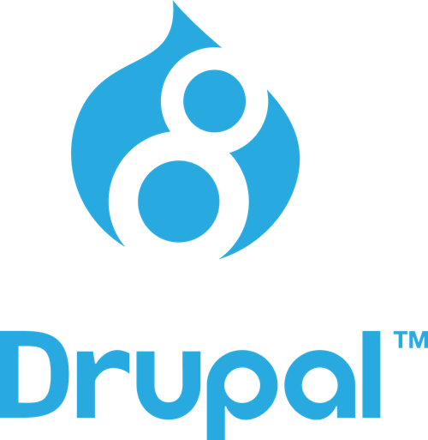

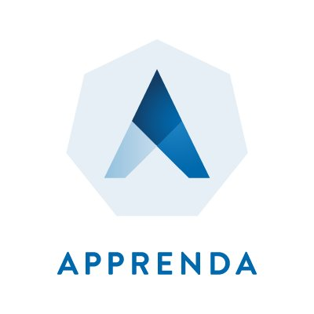
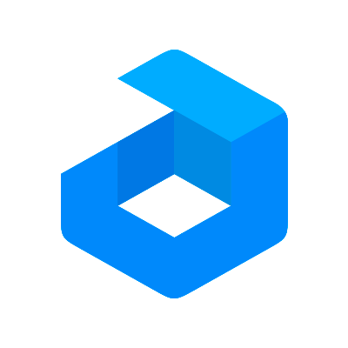



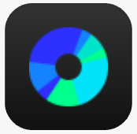



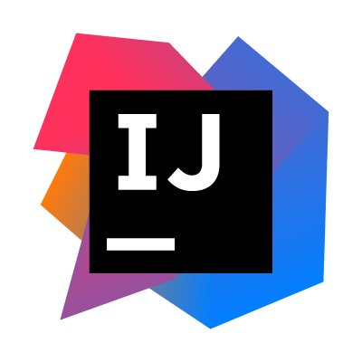





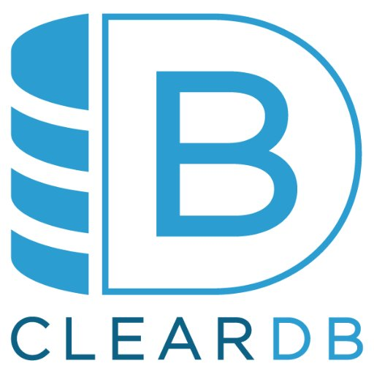
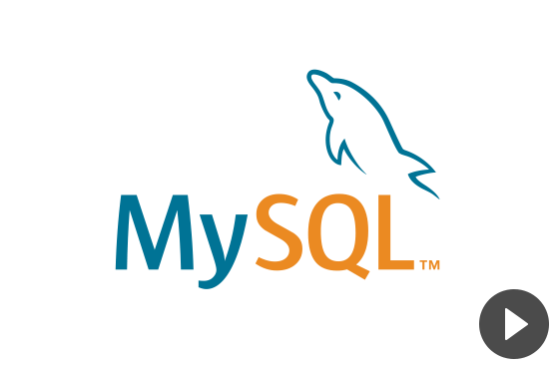

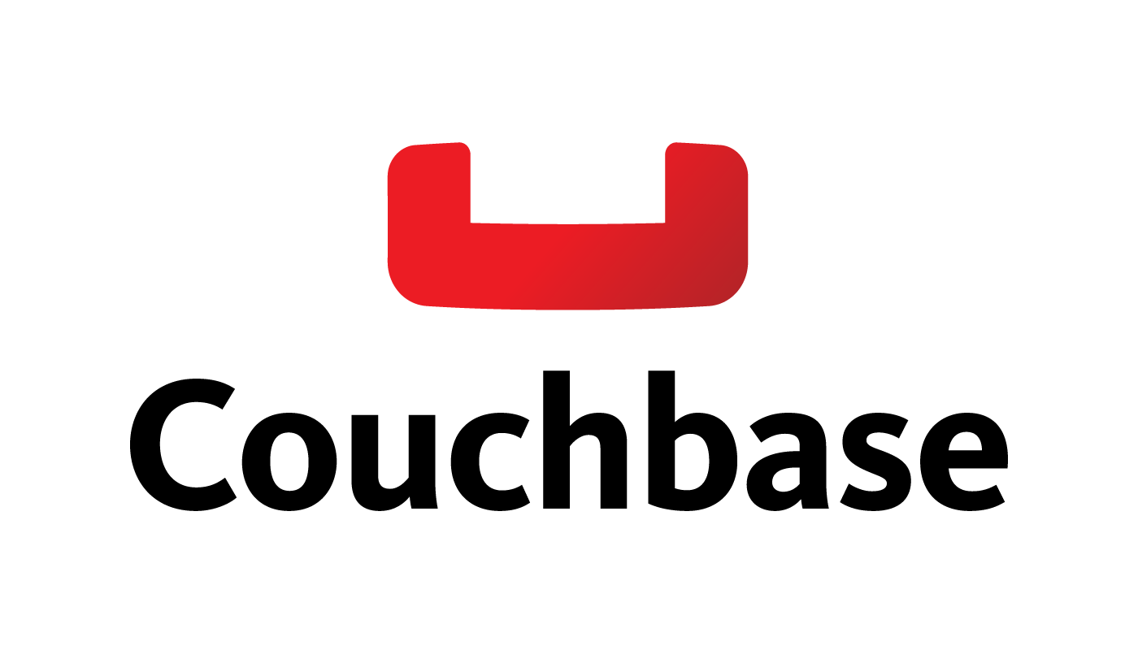






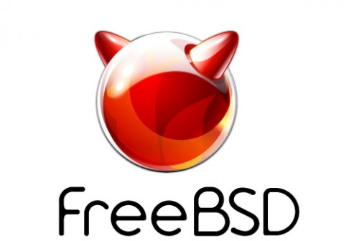




Build and innovate with choice and flexibility
DevOps
Management
Applications
App frameworks
& tools
Databases &
middleware
Infrastructure

Slide 13
Azure & Office 365 2-Day DevCamp

Slide 14
https://aka.ms/azcat-devcamp
Download DevCamp Content from GitHub

Slide 15
Course Agenda
Module 1
Module 2
Module 3
Module 4
Module 5
Module 7
Setting up your developer environment
Building modern cloud apps
Identity with Azure AD and Office 365 APIs
DevOps with Azure and Visual Studio Team Services
Module 6
Cognitive Services and the BOT framework
ARM and Infrastructure as Code
Monitoring applications with App Insights
Module 8
Choice IOT OR PowerBI

Slide 16
Hands on labs
HOL 1
HOL 2
HOL 3
HOL 4
HOL 5
Setting up your developer environment
Building modern cloud apps
Identity with Azure AD and Office 365 APIs
DevOps with Azure and Visual Studio Team Services
Infrastructure as code with Azure Resource Manager (ARM)
HOL 6
Monitoring applications with App Insights
HOL 7
Cognitive Services and the BOT Framework (AI)
HOL 8
Choice: IOT or PowerBI

Slide 17
Day 1 – Detailed Agenda
9:00 AM – 9:30
Overview
9:30 – 10:15
Tools and developer environment overview
10:15 – 10:45
HOL 1 - Tools and Developer Environment Setup
10:45 – 11:00
Break
11:00 -11:30
HOL1 - Tools and Developer Environment Setup (Cont'd)
11:30 - 12:15 PM
Modern Cloud Apps + Demo
12:15 -1:00
Lunch
1:00 - 2:00
HOL 2 - Modern Cloud Apps
2:00 - 2:15
2:15 - 3:15
Identity and Office365 APIs Overview + Demos
3:15 - 4:45
HOL 3 - Identity and Office365 APIs
4:45 - 5:00
Break
Q&A

Slide 18
Day 2 – Detailed Agenda
9:00 AM-9:15
10:00 - 10:15
10:15 - 11:15
12:00 - 1:00
Recap
9:15 - 10:00
Monitoring Lecture + Demo
Break
2:15 - 3:00
HOL 5 - Infrastructure as code (ARM)
2:00 - 2:15
Lunch
1:00 - 2:00
Infrastructure as code (ARM) + Demo
HOL 4 - Continuous integration with VSTS
11:15 - 12:00 PM
Break
DevOps with Azure Services + Demo
3:00 - 4:00
HOL 6 - Monitoring applications with App Insights
Q&A
4:00 - 4:45
Cognitive Services and the BOT Framework
4:45 - 5:00

Slide 19
Intro to Scenario
City Power & Light
Would like to allow field workers the ability to capture incidents
Would like to provide photo upload capability
is looking to use cloud capabilities
Would like to consume PaaS services on Azure

Slide 20
Demo
City Power and Light
Notes:
Demo steps
Show site
Login with Azure AD
Create new incident
Show dashboard
Show profile

Slide 21
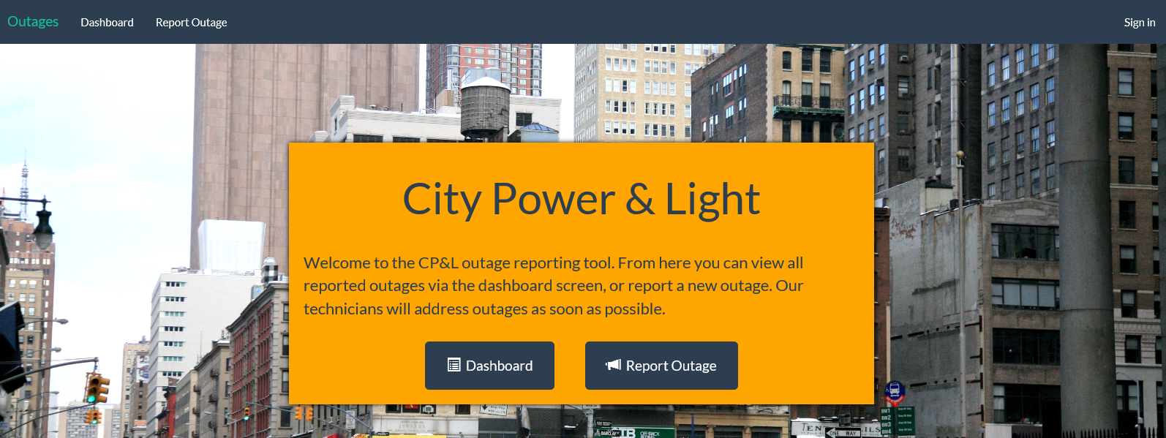
City Power & Light Outage Incident Tracker

Slide 22
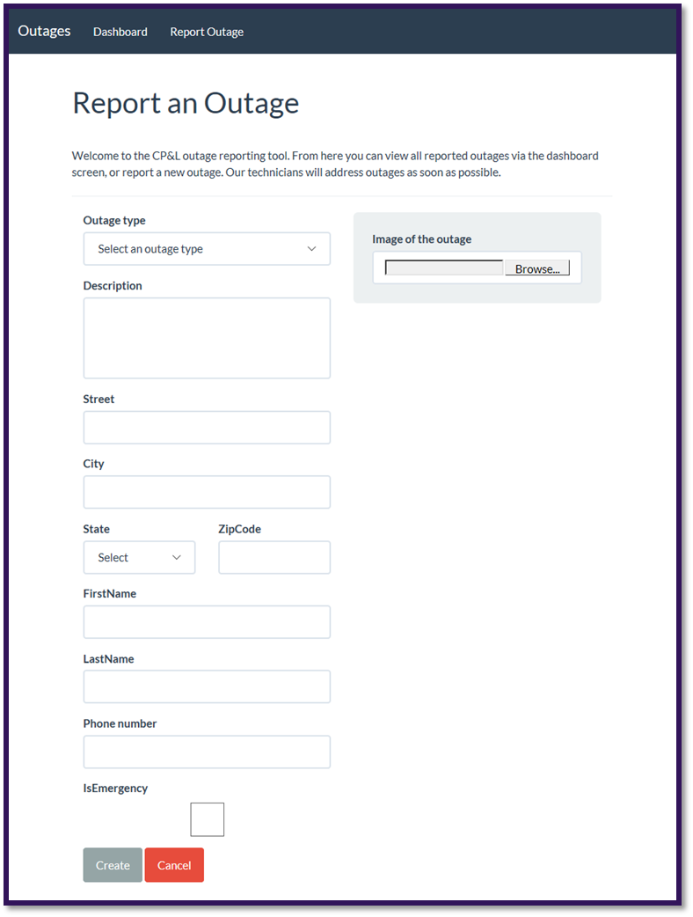
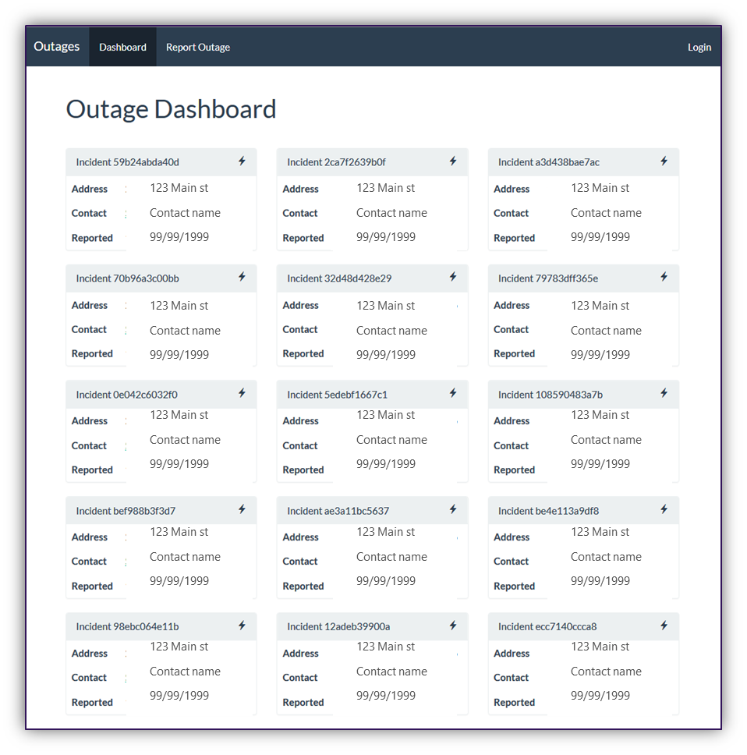
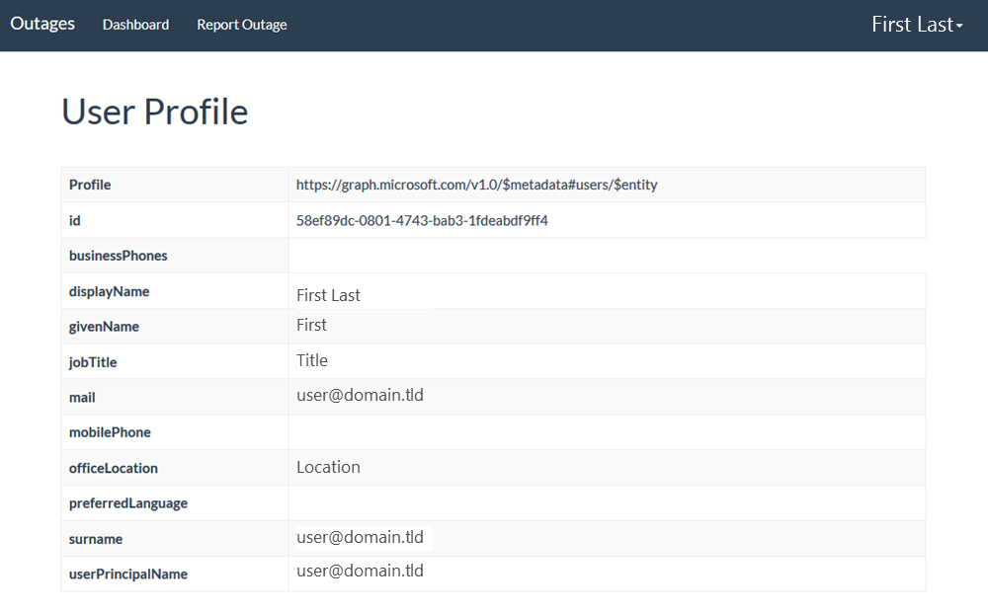
Screenshots

Slide 23




City Power & Light App Architecture
START
8
3
4
AZURE CosmosDB
AZURE API APP
AZURE CACHE
1
Dashboard
WEB SITE
New Incident
Incident Tracker
Email
Images
6
AZURE QUEUE
2
7
5
9
AZURE BLOB STORAGE
AZURE FUNCTION
AZURE AD
O365 APIs

Slide 24
Services Covered in this DevCamp
Azure
Azure Resource Manager
Virtual Machines (Windows)
Azure AD
Web Applications
API Apps
App Insights
Redis Cache
Cosmos DB
DevTest Labs
Bots
IOT
Office 365
Microsoft Graph API
Visual Studio Team Services
Source Control integration (GIT)
Continuous Integration & Delivery
Power BI
Reports, data sources

Slide 25
Hands On Labs

Slide 26
HOL 1: Setting up your developer environment
Create O365 Developer Tenant
Connect Azure subscription (Pass or Trial)
Take prepared image or run locally, walk through the tools that are available for your platform
.NET, Node.JS, Java | Windows.
Run ARM Template to scaffold out resources

Slide 27
HOL 2: Building modern cloud apps
Starting with provisioned resource group
Select front end app (.NET/Node.js/Java)
Connect to deployed API
Add blob storage
Add queueing
Add Redis cache
Stretch: Image resizing with Azure Functions

Slide 28
HOL 3: Identity with Azure AD and Office 365 APIs
Create AAD Application
Add authentication to app
Add profile page
Add graph API call to get user data for profile page
Populate first & last name of the new incident form with first name & last name from Graph/token
Send Email via Graph on new incident creation
Stretch: Add calendar event on new incident creation

Slide 29
HOL 4: DevOps with Azure and VSTS
Create Visual Studio Team Services (VSTS) Online account
Create Git repository
Clone Git repo locally
Push code into VSTS
Create CI pipeline for build
Ends with published artifacts

Slide 30
HOL 5: Infrastructure as code with (ARM)
Create ARM template for web app in VS
Deploy using VSTS
Create 1 Production environment
Configure Continuous deployment

Slide 31
HOL 6: Monitoring applications with App Insights
Add App Insights resource to Azure
Add App Insights to application server side
Monitor the API call
Add client side library
Dashboard custom event to capture dashboard views
Create availability test that test the dashboard
Stretch - Create custom metric around the API call

Slide 32
HOL 7 – Cognitive Services and Bots
Set up the developing environment to support the creation of bot applications
Create your own bot from scratch
Create your own bot using Azure Bot Service
Hosting your bot in Azure

Slide 33
HOL 8 – Power BI / IOT
PowerBI
Connect to data in Cosmos DB using Power BI
Add a calculated column to a Power BI report
Publish and view a report to the Power BI service
IOT
Install the Arduino SDK
Connect with VS and create connection solution
Deploy and Test
NOTE: use your phone’s Hotspot NOT the MSFTGUEST

